Slide 1

AMSTELHAEGE
Duncan Barker
Thomas Stephens
Jonathan Klaiber
Heuristics – Team Stadplanning Amsterdam

Slide 2
CONTENT
What we have done so far
What we will do next
Questions

Slide 3
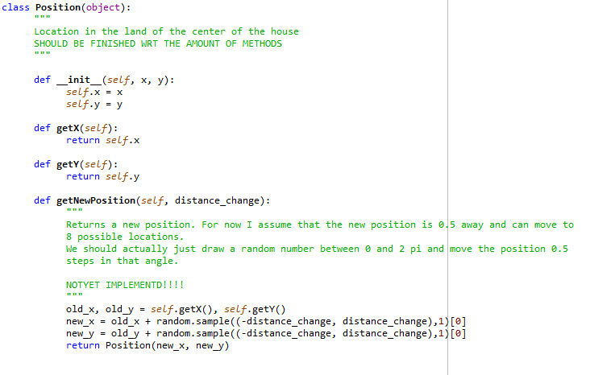
What we have done so far ...
Class Position
Position object to store location of houses

Slide 4
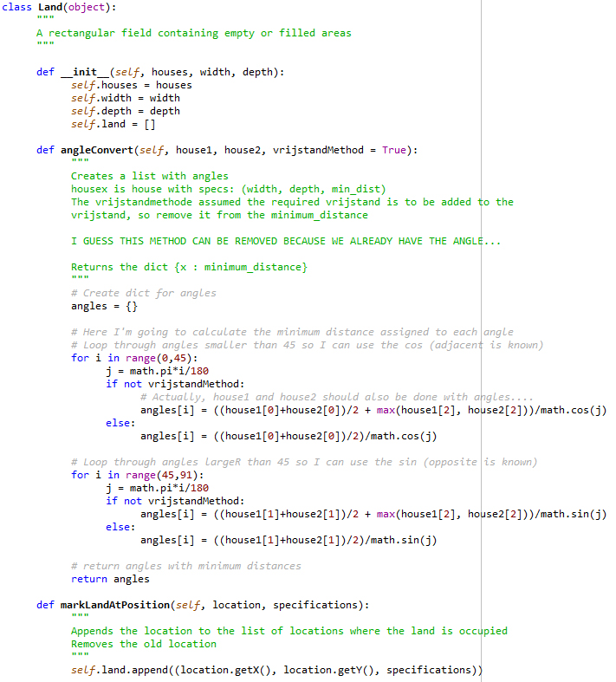
What we have done so far ...
Class Land
Representation of area
House information is stored in a tuple (width, depth, specs) and house tuples in a (land) list.
Methods:
__init__
angleConvert
markLandAtPosition
removeLandAtPosition
checkPosition
getTotalVrijstand
getVrijstand
isPositionInLand

Slide 5
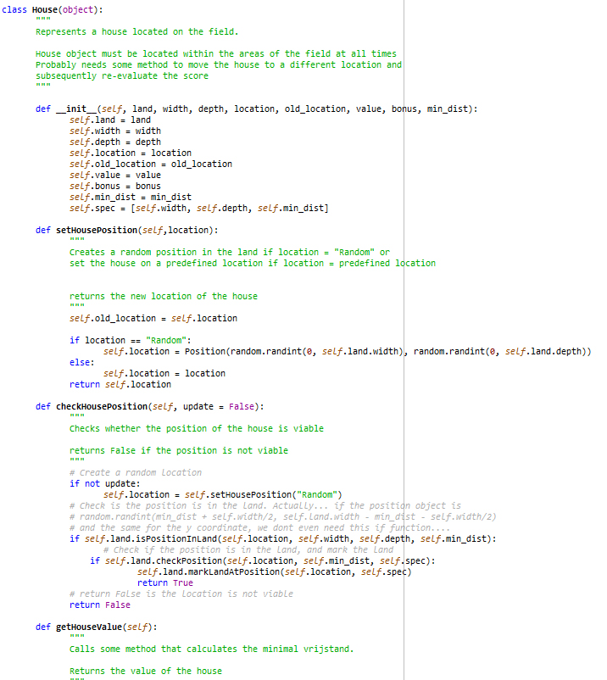
What we have done so far ...
Class House
Representation of a house
Class House has 3 subclasses:
Small(House)
Medium(House)
Large(House)
Methods:
__init__
setHousePosition
checkHousePosition
getHouseValue
getHousePosition
getOldHousePosition
updatePosition

Slide 6
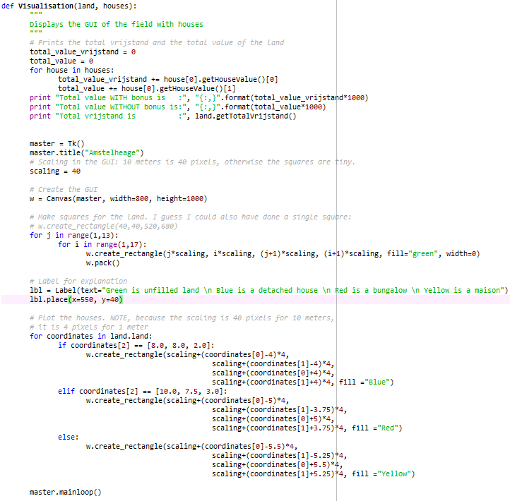
What we have done so far ...
Function Visualisation
GUI – Visualisation of land with houses

Slide 7
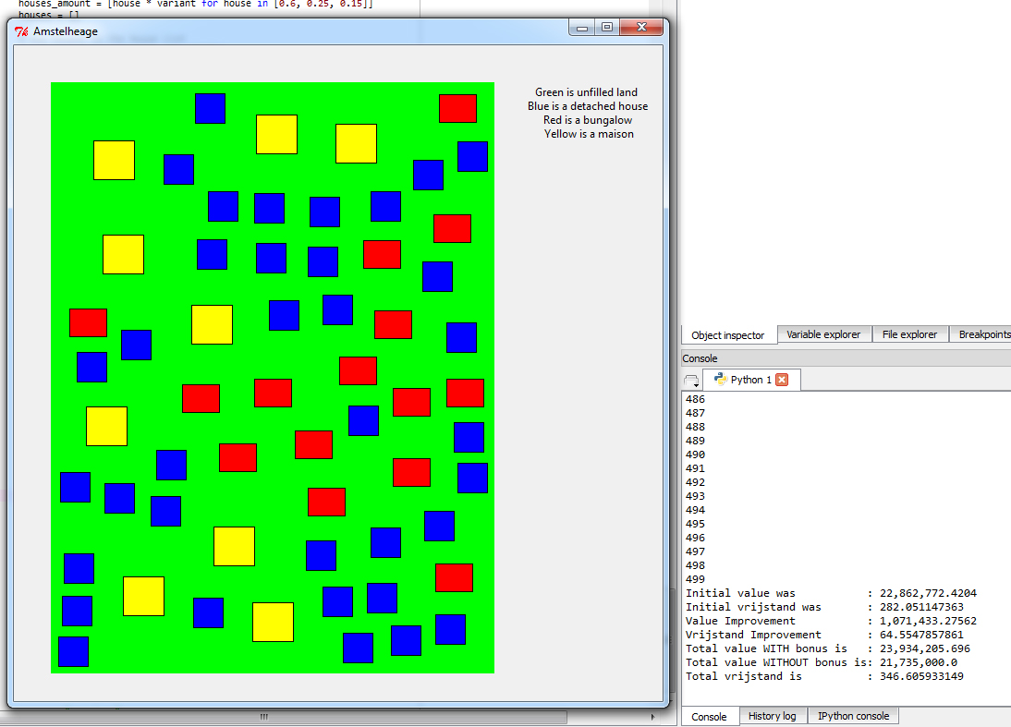
What we have done so far ...
Function Visualisation
GUI – Visualisation of land with houses

Slide 8
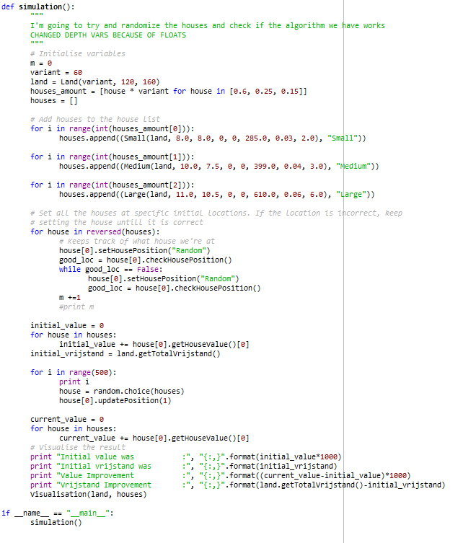
What we have done so far ...
Function Simulation
Def simulation sets houses on land and relocates houses to better positions
Algorithm:
takes a random house
gets a new position
checks if position is in land
checks if position has enough „vrijstand“
checks is house value or vrijstand has increased
if increased, keep new position, else return to old position
repeat

Slide 9
What we will do next...
Overview
Test the code we have so far
Make code more efficient
Evaluate which class methods we really need
Improve speed of „vrijstand“ (and total value) computation
Improve algorithm

Slide 10

Questions & Comments

